Slide 1
One Day Administrative Staff Training programme on
Orientation programme on Use of NATIONAL SCHOLARSHIP PORTAL
8th February 2016
Organised by Internal Quality Assurance Cell (IQAC)
SDM Govt. Music College, Agartala

Slide 2
https://scholarships.gov.in/

Slide 3
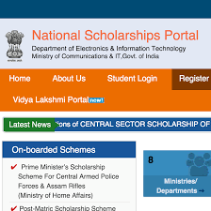

Slide 4
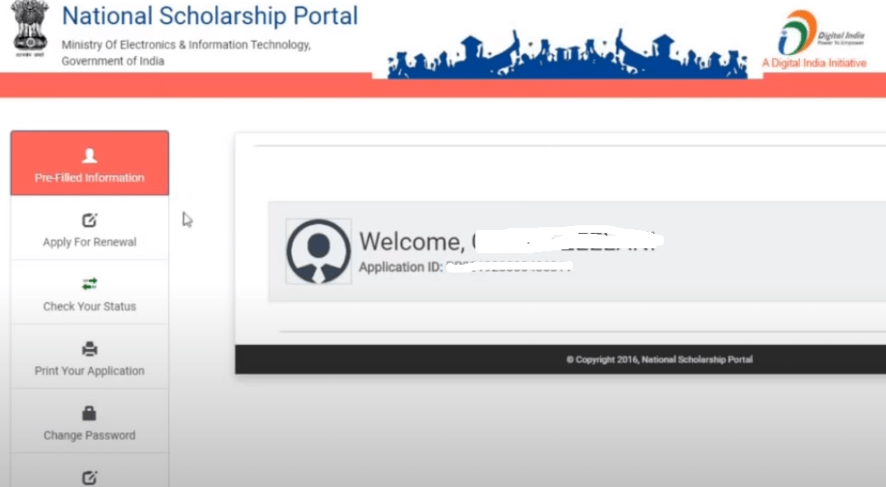
National Scholarship Portal

