Slide 1
One Day Faculty Development Program on
Use of Social Media to Help Students
5th January 2019
Organised by Internal Quality Assurance Cell (IQAC)
SDM Govt. Music College, Agartala

Slide 2




Different Types of Social Media
FACEBOOK
WHATSAAP
TWITTER
YOUTUBE

Slide 3
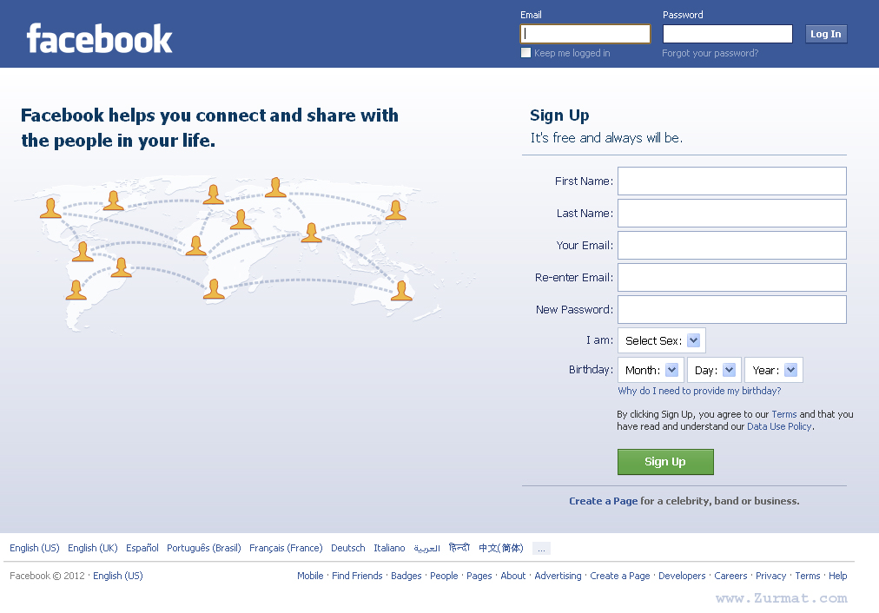
Facebook

Slide 4
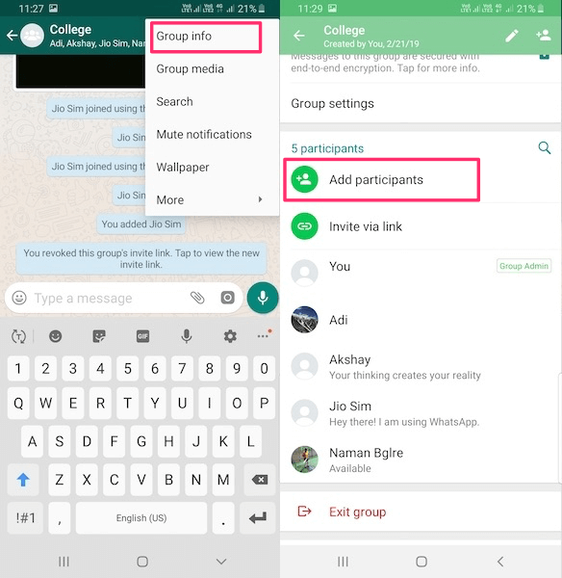

Whats AAP

Slide 5
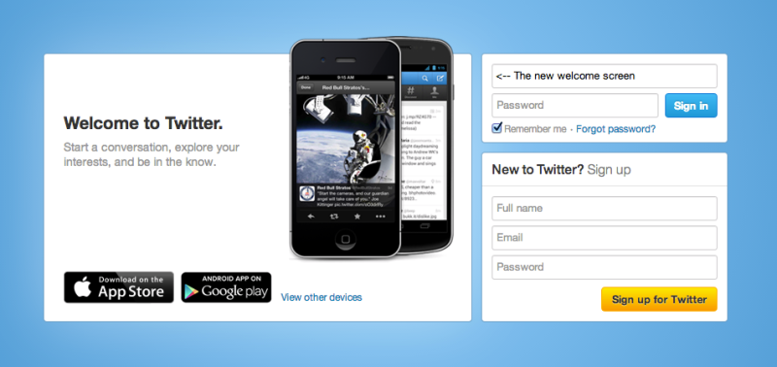
Twitter

Slide 6
Thank you
IQAC, SDMGMC-Agartala

