Slide 1
One Day Faculty Development Program on
Online Class Using ZOOM & GOOGLE MEET
24th December 2020
Organised by Internal Quality Assurance Cell (IQAC)
SDM Govt. Music College, Agartala

Slide 2



Online Class Apps
Google Meet
Zoom
Cisco Webex

Slide 3
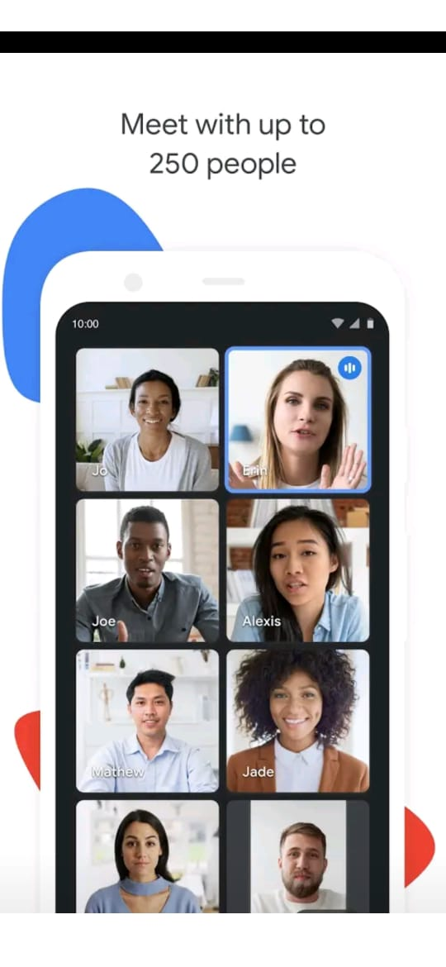
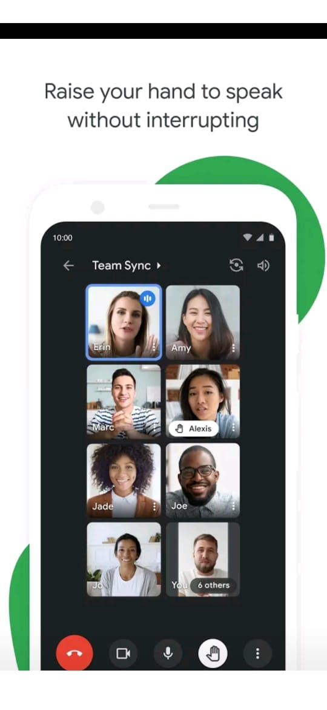
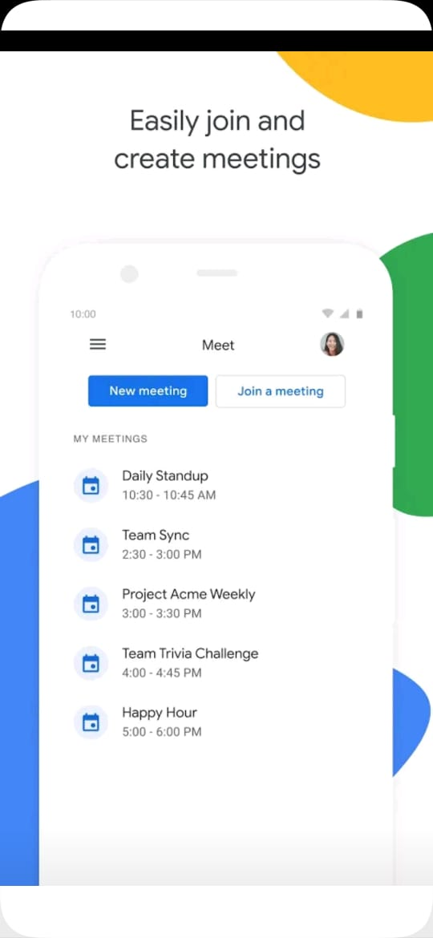
Google meet

Slide 4
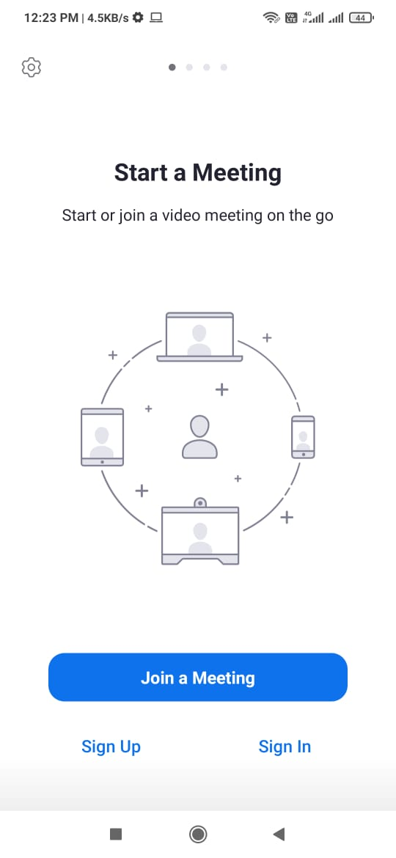
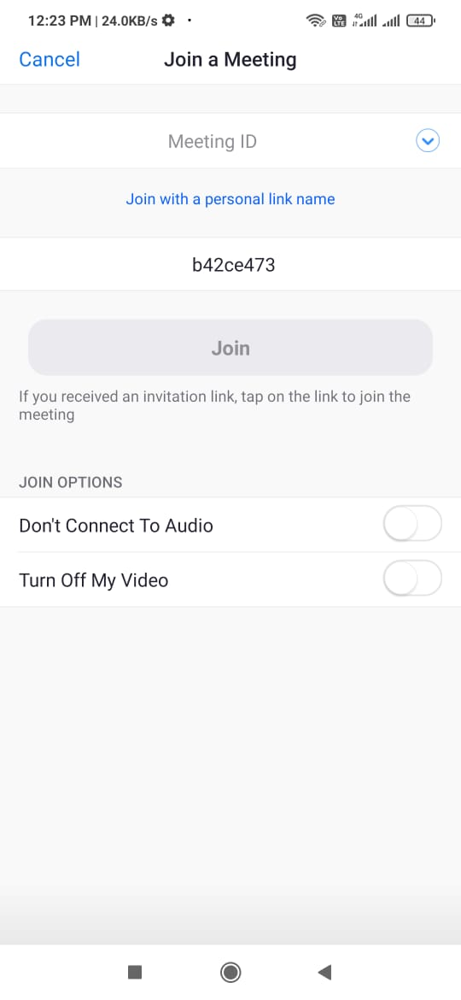
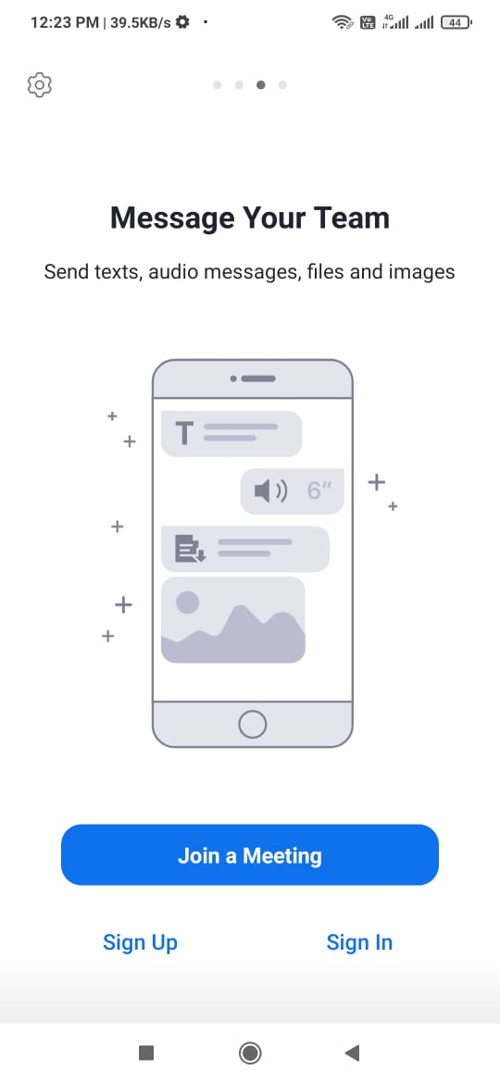
Zoom App

Slide 5
Thank you
IQAC, SDMGMC-Agartala

