Slide 1
One Day Administrative Staff Training Programme on
Professional Development Programme on
USE OF MS EXCEL
Date: 21/07/2017
Organised by Internal Quality Assurance Cell (IQAC)
Sachin Debbarma Memorial Govt. Music
College, Agartala

Slide 2
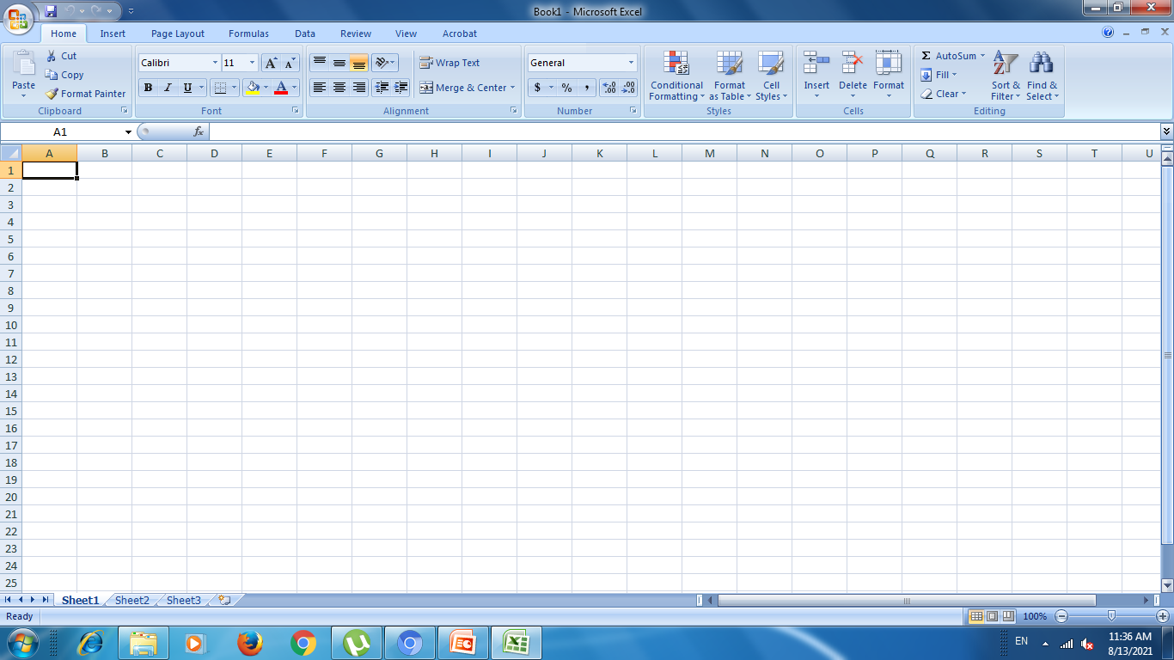
Home screen of MS Excel

Slide 3
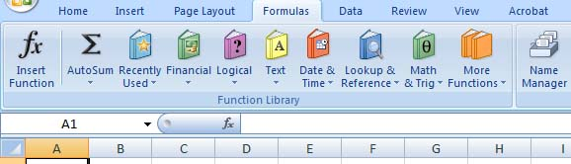
Formulas

Slide 4
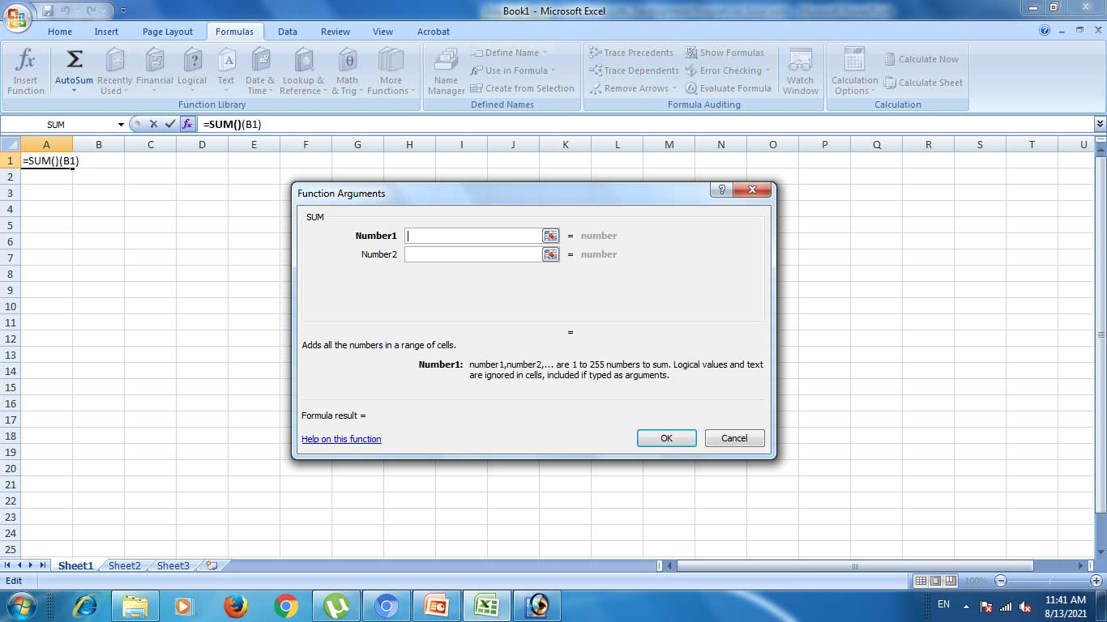
SUM: Formula

Slide 5
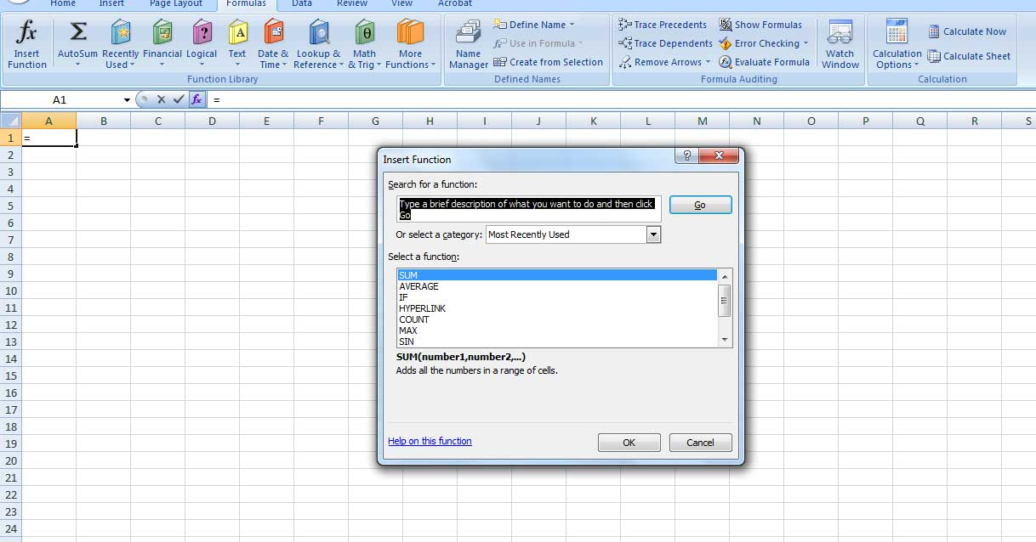
Fx formulas

Slide 6
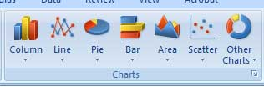
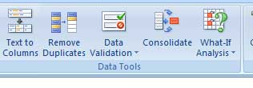
Others Advantages
Preparing Charts
Data Tools

Slide 7
Thank You
IQAC-SDMGMC

